Slide 1
Pandas Recap
To select a column you use:
data_frame[[“list_of_columns”]]
temperature = clean_data[['temp’]]
temperature_and_wind = clean_data[['temp','wspd’]]
To select a column you use the .loc method
data_frame.loc[“index_of_choice”]
Christmas_night = clean_data.loc["2024-12-25 00:00:00"]
data_frame.loc[“starting_index”: “ending_index”]
data_frame.loc[“encompassing_index”]

Slide 2
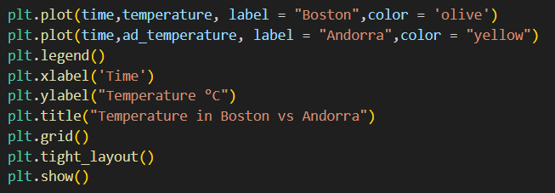
Matplotlib Recap

Slide 3
Exercise
Using meteostat, choose a location in spain, and get the weather data from July 1st 2023 to January 1st 2025
Remember how we input dates and coordinates into meteostat
Clean the data
Get the wind data from the first 7 days of 2024
Plot it over time

Slide 4
Pandas Recap
To select a column you use:
data_frame[[“list_of_columns”]]
temperature = clean_data[['temp’]]
temperature_and_wind = clean_data[['temp','wspd’]]
To select a column you use the .loc method
data_frame.loc[“index_of_choice”]
Christmas_night = clean_data.loc["2024-12-25 00:00:00"]
data_frame.loc[“starting_index”: “ending_index”]
data_frame.loc[“encompassing_index”]

Slide 5

Saving and reading CSV files
CSV stands for “Comma Separated Values”, like an excel file
Right now you should have a variable that stores the data frame.
It’s useful to write that variable into a csv file

Slide 6

Saving and reading CSV files
CSV stands for “Comma Separated Values”, like an excel file
Right now you should have a variable that stores the data frame.
It’s useful to write that variable into a csv file
We can later read that file again

Slide 7
Saving and reading CSV files
CSV stands for “Comma Separated Values”, like an excel file
Right now you should have a variable that stores the data frame.
It’s useful to write that variable into a csv file
We can later read that file again
How do we know if it worked?

Slide 8
Saving and reading CSV files
CSV stands for “Comma Separated Values”, like an excel file
Right now you should have a variable that stores the data frame.
It’s useful to write that variable into a csv file
We can later read that file again
How do we know if it worked?
PRINT!!!!

Slide 9
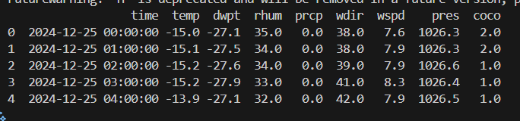
Saving and reading CSV files
Something’s wrong

Slide 10
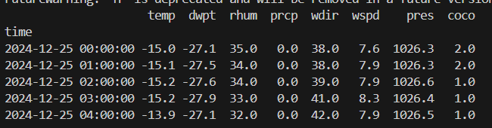
Saving and reading CSV files
Something’s wrong

Slide 11
Saving and reading CSV files
index is messed up

Slide 12

Saving and reading CSV files
CSV stands for “Comma Separated Values”, like an excel file
Right now you should have a variable that stores the data frame.
It’s useful to write that variable into a csv file
We can later read that file again
How do we know if it worked?
PRINT!!!!

Slide 13
Saving and reading CSV files
CSV stands for “Comma Separated Values”, like an excel file
Right now you should have a variable that stores the data frame.
It’s useful to write that variable into a csv file
We can later read that file again
How do we know if it worked?
It works!!!!

Slide 14
Next part of the project: data acquisition (again)
Navigate to this website:
https://demanda.ree.es/visiona/peninsula/demandaqh/tablas/2024-12-10/2

Slide 15
Error handling
Most of your time when programming, you will spend it debugging
Errors are a clear sign of some sort f bug
When you see an error, you should not be scared and give up
You should identify where the error is happening
Read and try to understand what it’s saying
Find the reason why it’s happening
Fix the error

Slide 16
Error handling
Error messages are a tool!

Slide 17
Error handling and AI
One of the most useful tools you have at your disposal, is AI
They have a great ability at reading erros and translating them to you
A good and efficient practice when programming is using AI to help you debug!

Slide 18
Error handling and AI
Copy your code
Copy the error message
Copy any data types that you might be working with
Explain your goal

Slide 19
Controlled error handling
Let’s look at how errors might appear in our work
Using AI, what find out what the error means and ways to solve it
Give it all the information that it might need

Slide 20
Controlled error handling
AI is powerful but it can’t always find the answer
In those instances you have to try different things to try to fix the error
One methodology that is particular is to look at instance or example where the action you’re performing works and see what’s the difference with what you’re doing now

Slide 21
Controlled error handling
Maybe the issue is in the file that we are reading!!

Slide 22
Controlled error handling
What’s wrong with the file we’re trying to read compared to the one we read before???

Slide 23
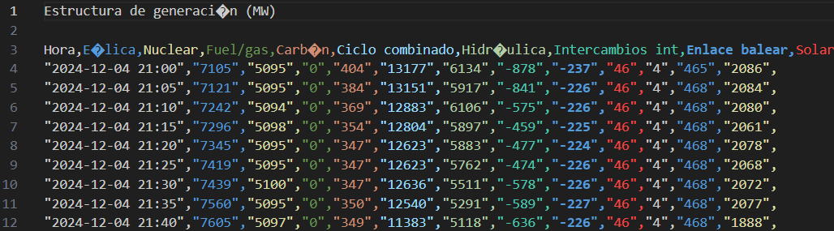
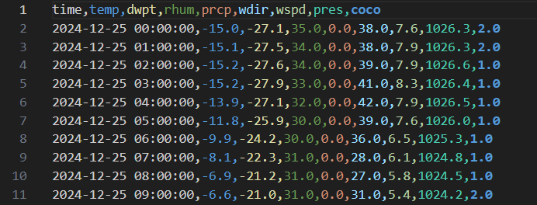
Controlled error handling
What’s wrong with the file we’re trying to read compared to the one we read before???

Slide 24
Controlled error handling
What’s wrong with the file we’re trying to read compared to the one we read before???

Slide 25
Controlled error handling

Slide 26
Manipulating files in your directory with python
Right now, we can read the files we downloaded
But we have a lot of files (a lot!!) in our folder
Going through them one by one would take wayyy too much time
To manipulate all these files, we will use a new library
os

Slide 27
OS
We have a lot of files that we want to work with
Going through them one by one would take wayyy too much time
os library allows us to manipulate the files in our directory
import os

Slide 28

OS
We’re gonna use this library to change the name of the files of interest in our directory
Get the directory we are working on at the moment
Get all the files in the directory

Slide 29
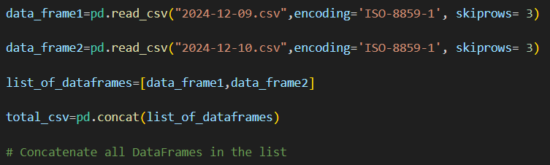
Concatonating
Now that we can successfully read the files we downloaded with error we’ll perform a small exercise
I’d like to combine all the files we downloaded into 1 large csv file
We can combine multiple csv files as follows

Slide 30
Pseudocode
Get a list of all the files in the directory (remember os)
Loop over all the filenames in the list
If the file is one of the files we want
Read the file and save it into a data frame, (remember the errors)
Append the data frame into a list
Total_csv = pd.concact(list_of_data_frame)

